Slide 1
Class design and Graphic user interface
members: G.Badamgarav
Ts.Khongorzul

Slide 2
topic
Introduction
Use case
Class design
GUI
Summary

Slide 3
Introduction
Our project name is “ Car business system ”.
By this presentation we will introduce how we made Class design and GUI.
Classes and relationship of classes show in this section.

Slide 4
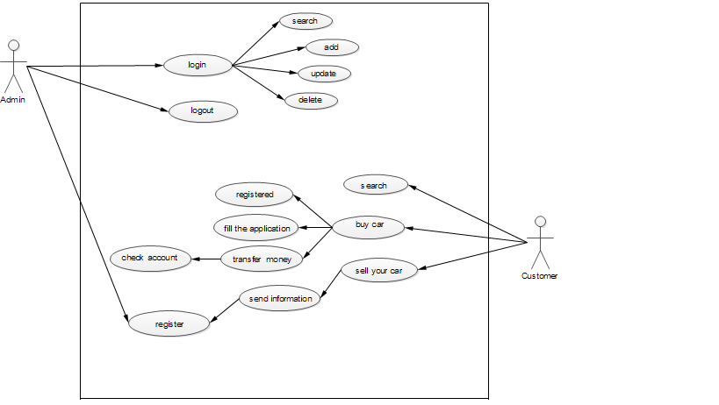
Use case

Slide 5
Class design
Our project has got next class design and consist of five classes.

Slide 6
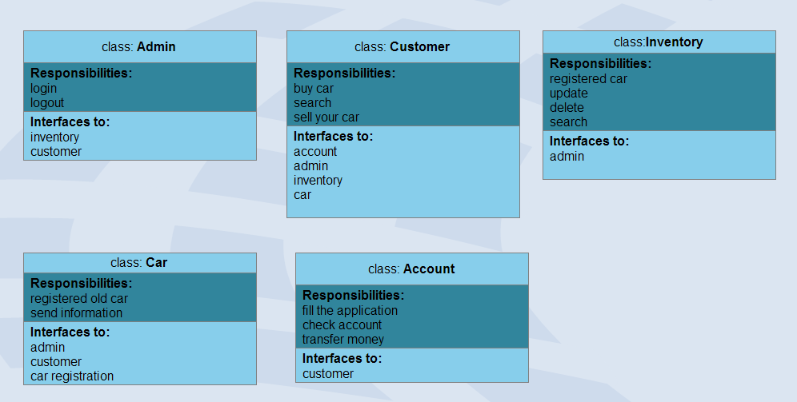

Slide 7
GUI design
Our project has got 2 types users.
Admin
Customer

Slide 8
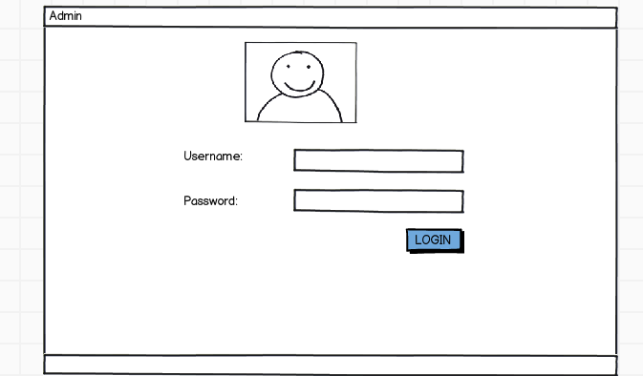
Admin`s GUI design

Slide 9
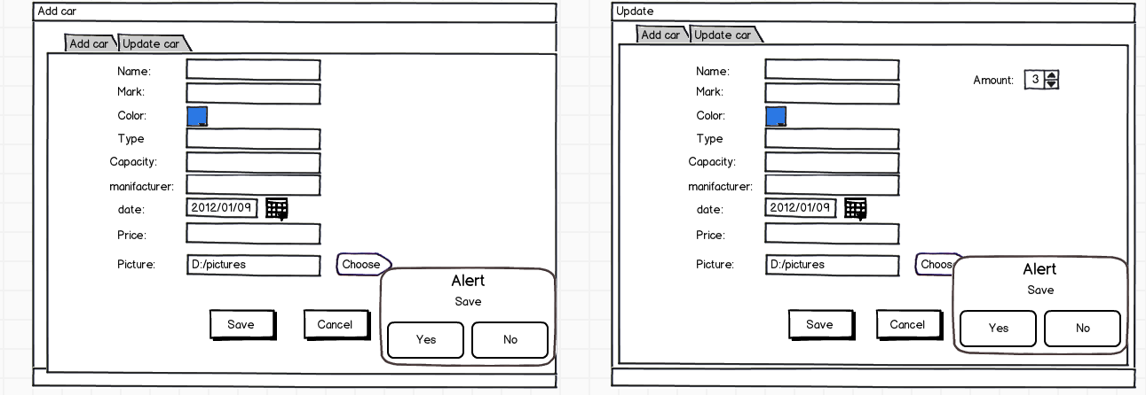
Admin`s GUI design
If this car sold, admin will decrease the amount .
If this car yet haven`t amount is 0.

Slide 10
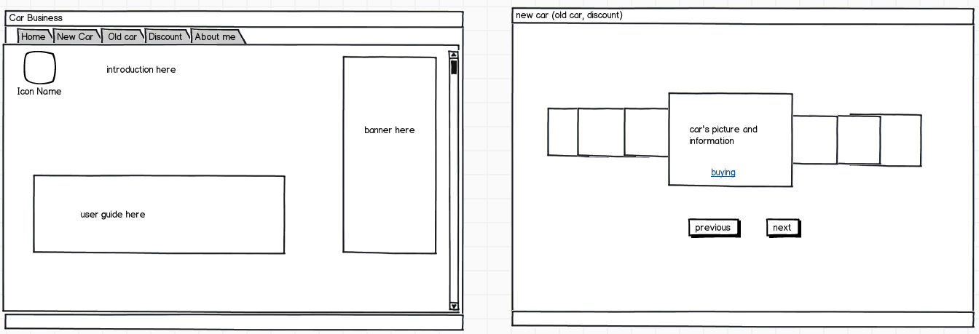
Customer`s GUI design
This page has consist of car information. /new car, old car and discount car/

Slide 11
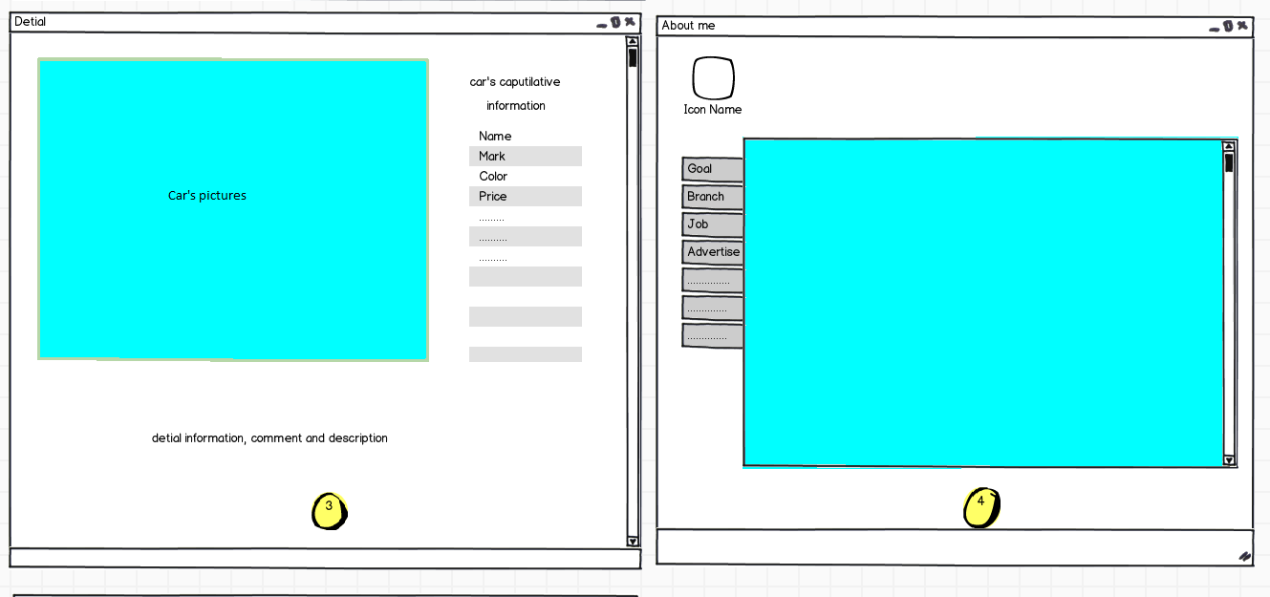
Customer`s GUI design

Slide 12
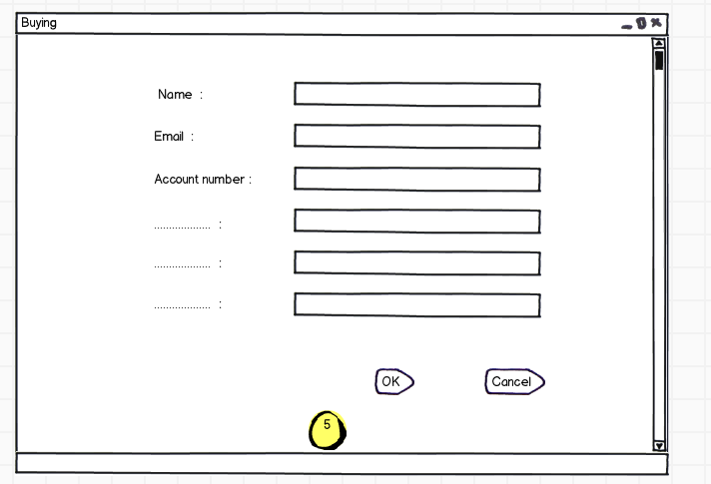
Customer`s GUI design

Slide 13
Summary
These are not final version of graphic user interface and class design yet. We will developing any more time for implementing process.

